Slide 1
Campus Parking Availability App
Group 8 - KLY Inc.
By: Mohammad Asif, Dylan Capece, Everett McCrea, Luke Padgett, Blake Stroud
Meeting times: Wednesdays at 6:20 pm - Google Hangouts video call

Slide 2
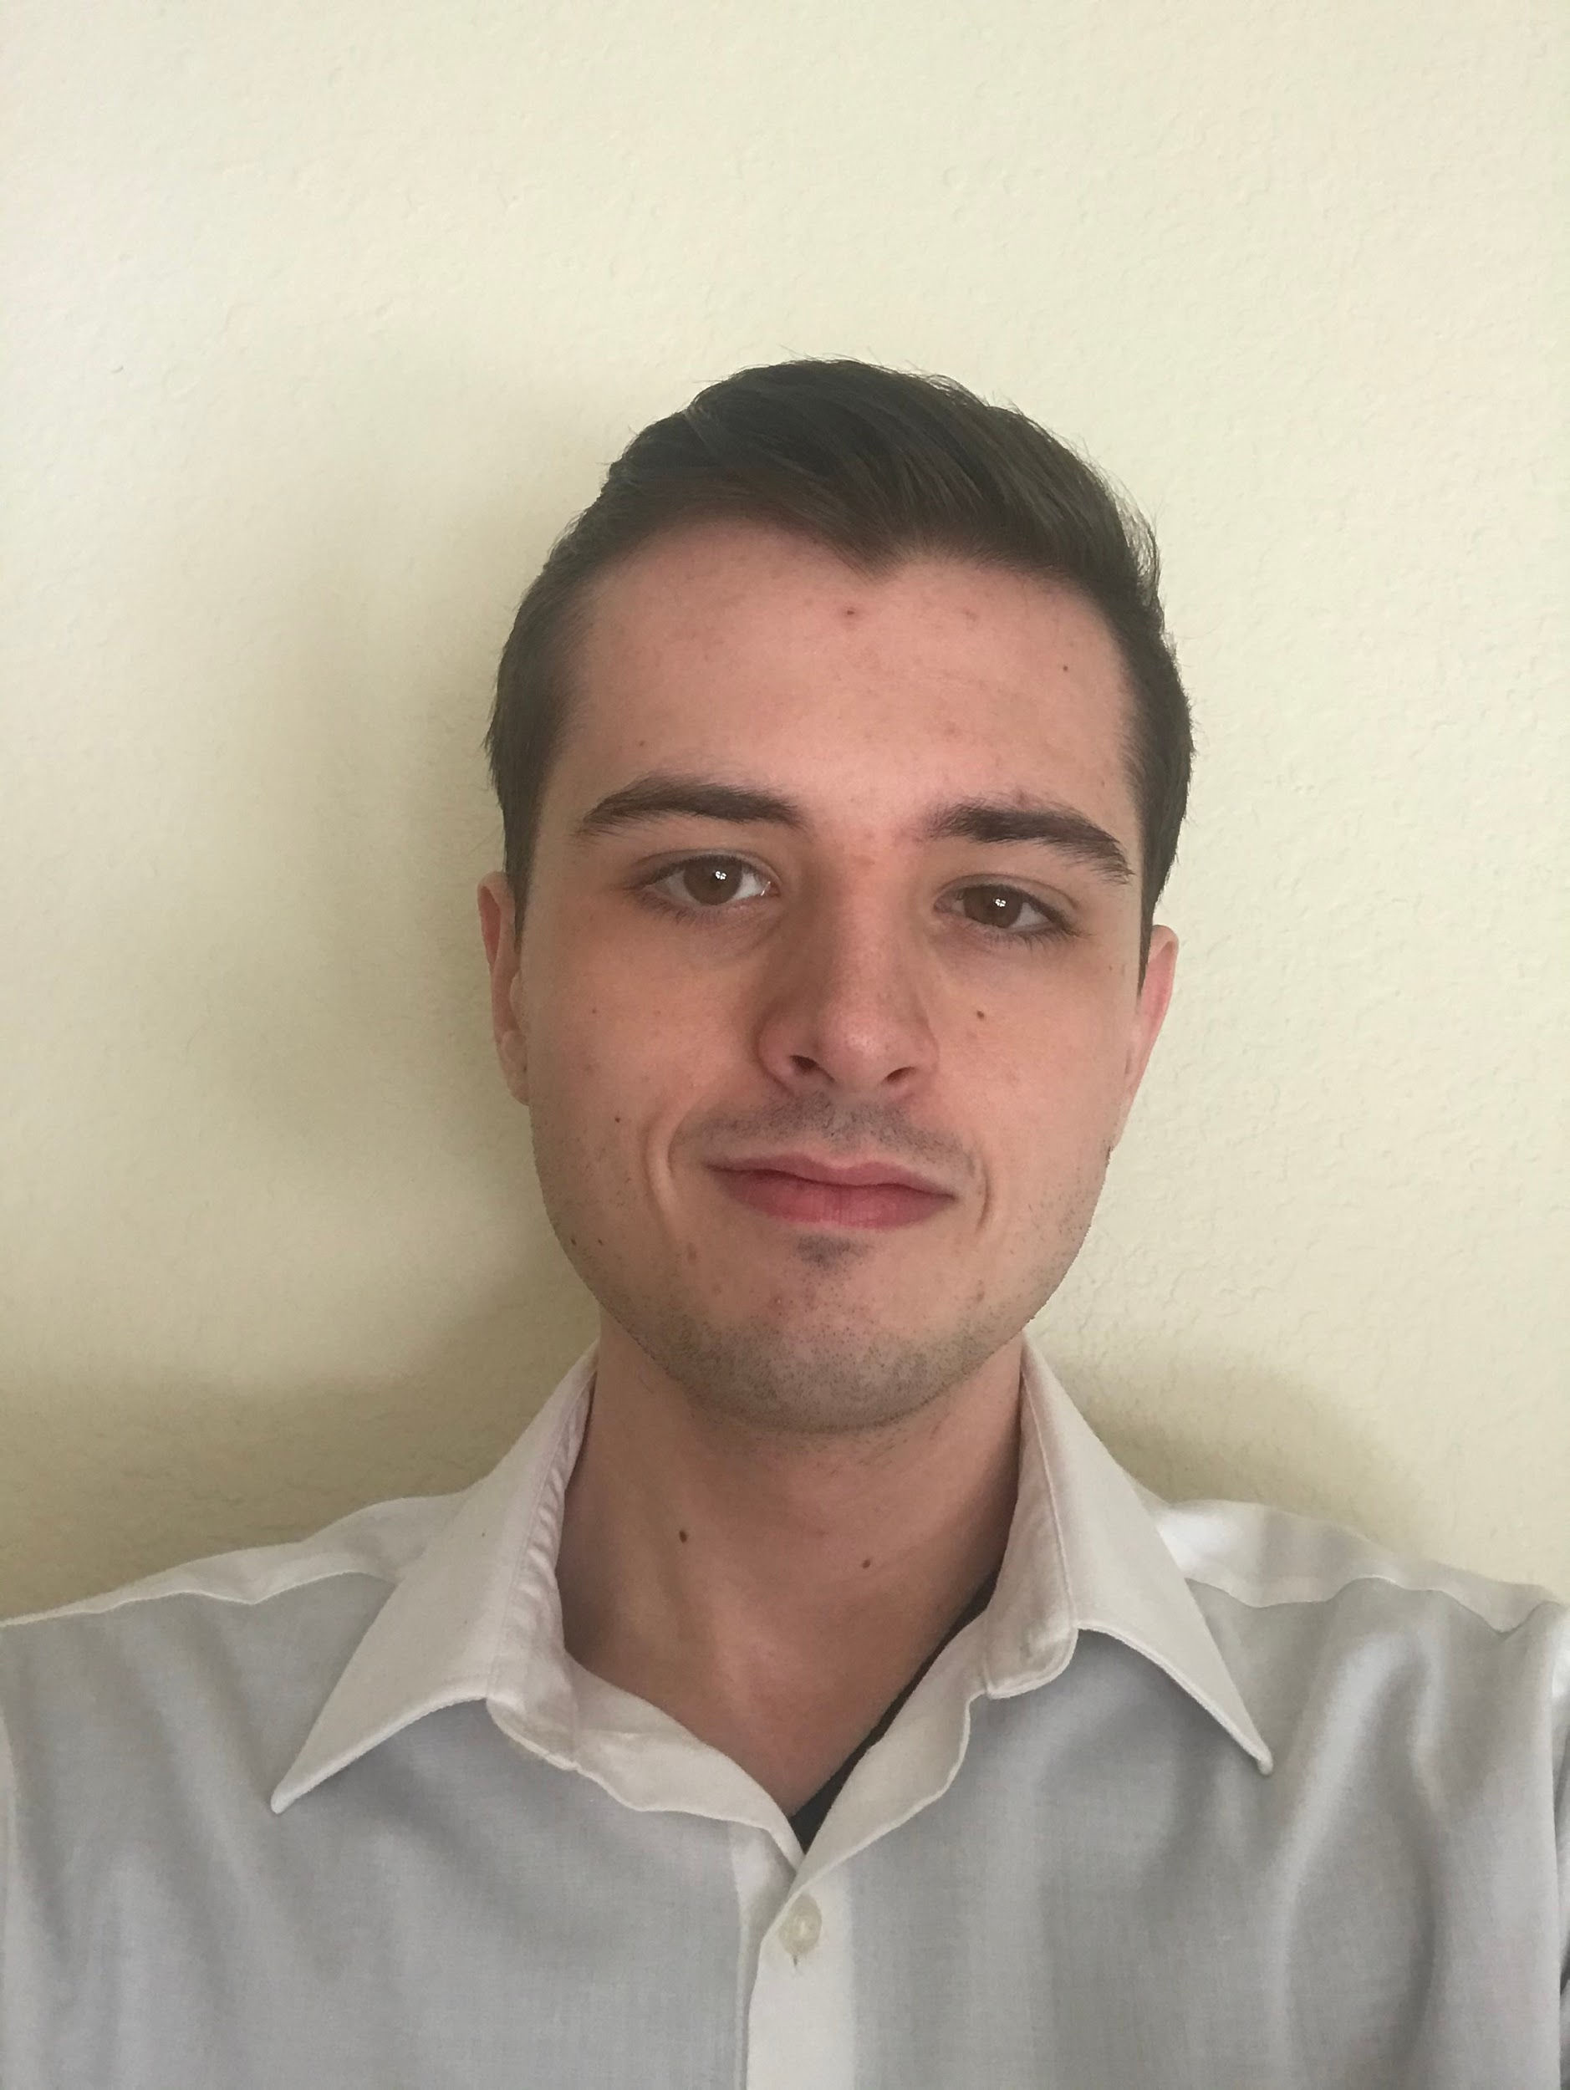
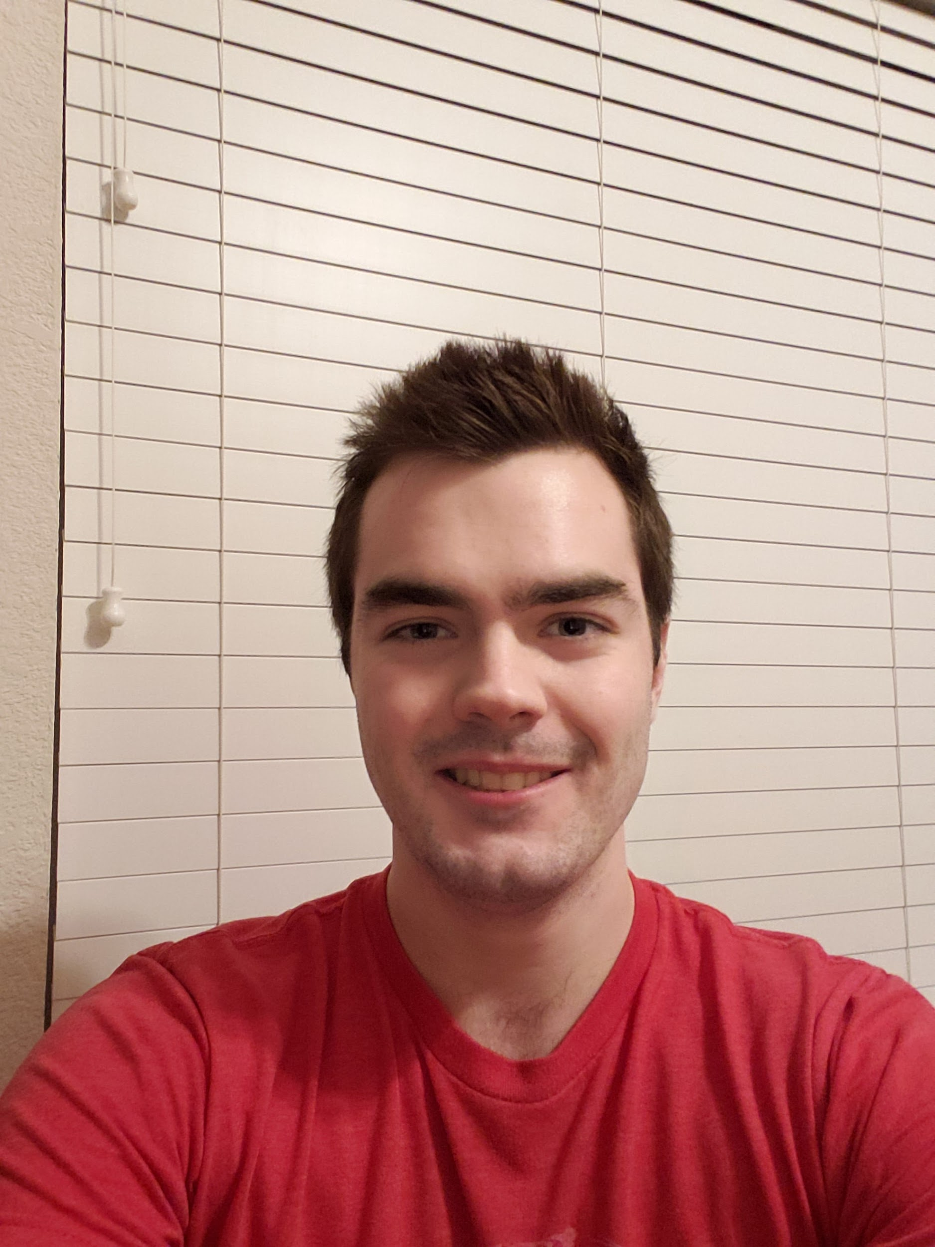
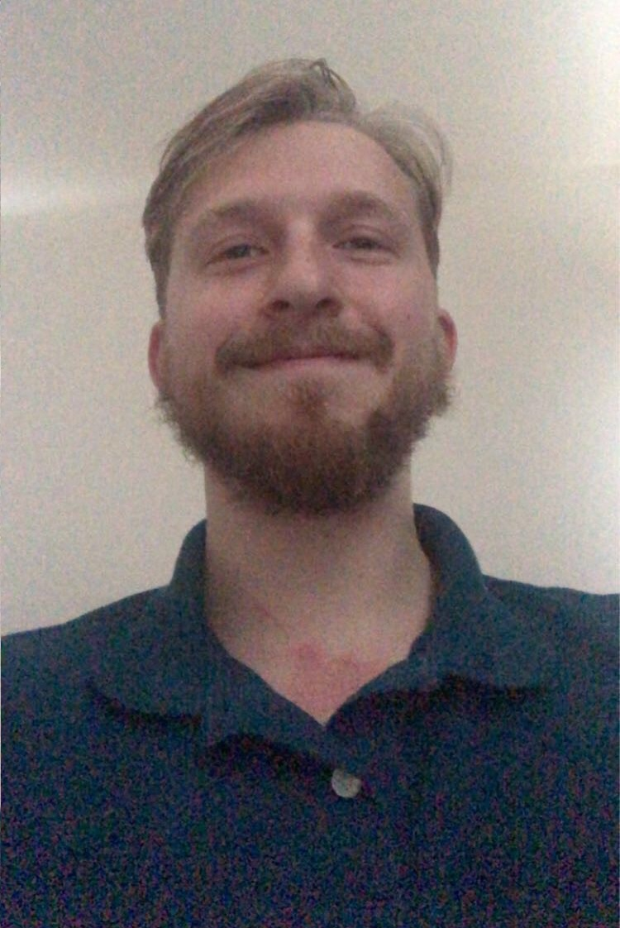
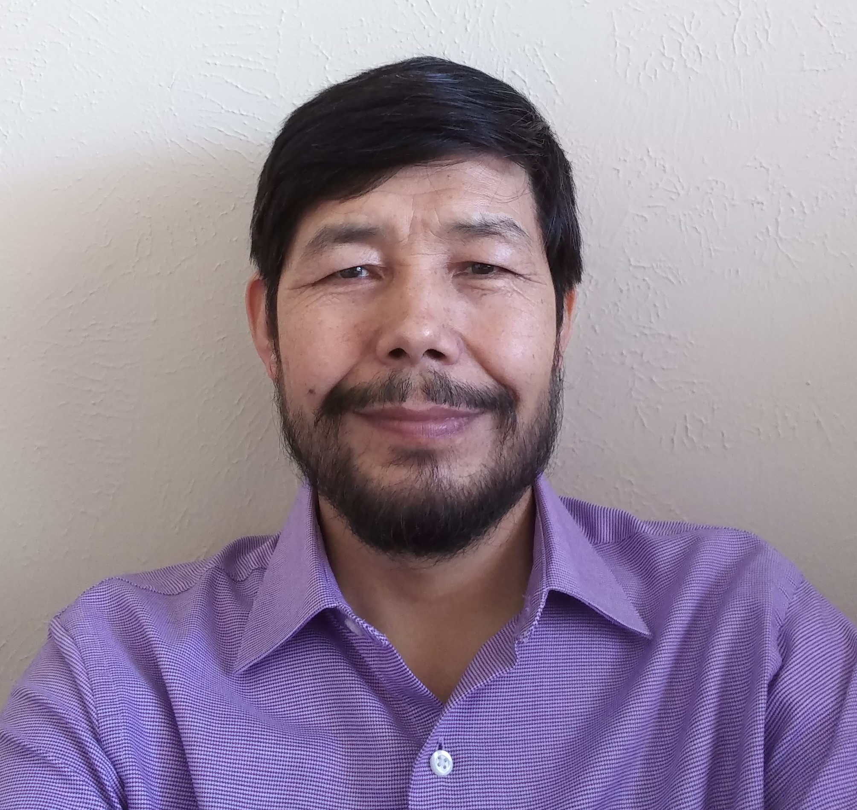
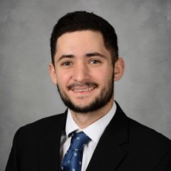
Everett McCrea
Software Engineering
Junior
Skills: Java, Cloud Computing
Job: Java Application Dev
Mohammad Asif
Software Engineering Junior
Skills: C++, Java
Job: Application Development
Luke Padgett Software Engineering Junior Skills: Java, Javascript
Job: Enterprise Java Dev
Dylan Capece
Software Engineering
Senior
Skills: Java, C++
Job: Application Development
Blake Stroud
Software Engineering
Senior
Skills: C++/C, Python
Job: Embedded Systems Engineer

Slide 3
Project Overview
App that shows real-time map of UTD parking availability
Track open spaces via car sensors and antennas at entrance of parking lot
Report number of cars in a lot to host system, then report to users
Track cars leaving parking lot
Detect which parking sticker cars have
Fix the UTD parking problem

Slide 4
Business Value
Save time and fuel
Less pollution
Increase end user satisfaction
Can charge a small fee
$2 a per week

Slide 5
Why Us
We have the necessary technical skills
Engineering and Computer Science majors
Motivated to fix a issue that affects us personally
Desire to improve the student experience
Knowledgeable of what the key issues are
Understand the potential that we can achieve with this service

Slide 6
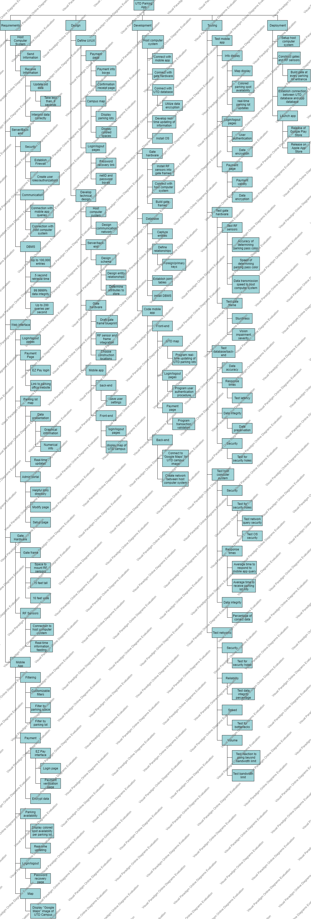
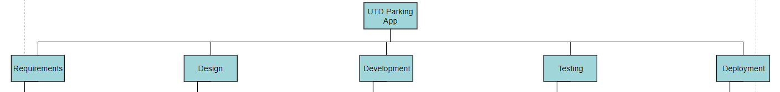
Work Breakdown Structure
Broken down into 5 stages of software lifecycle
Requirements, Design, Development, Testing, Deployment

Slide 7
WBS: Requirements
Mobile app
Gate hardware
Web interface
Server/back-end
Host computer system
What the system should be able to achieve
Broken down into functional areas

Slide 8
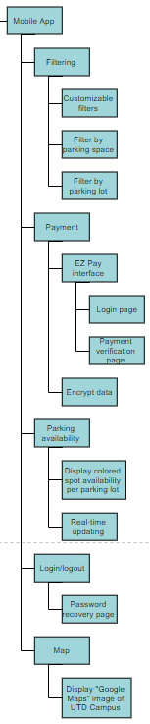
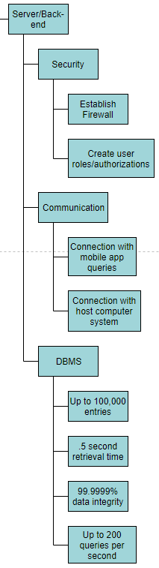
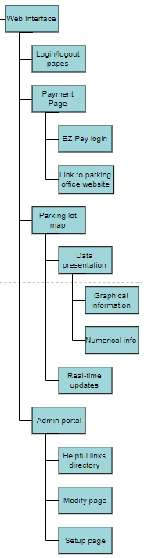
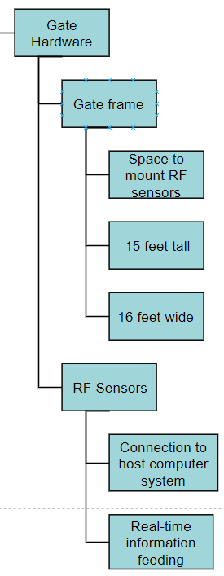
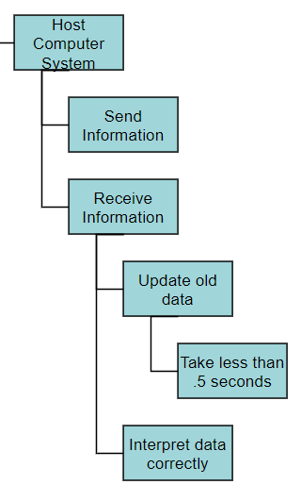
WBS: Requirements

Slide 9
WBS: Design
Define UI/UX
Develop Technical Design
Design what is important to end users
Design essential architecture for system to work

Slide 10
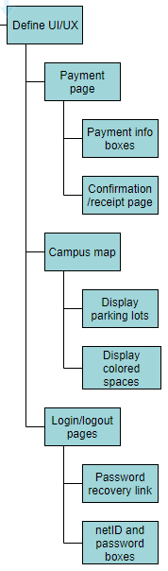
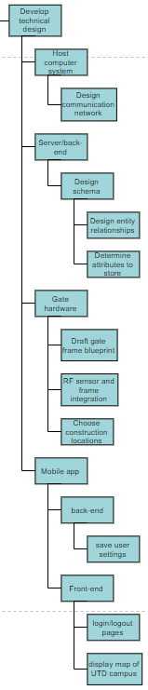
WBS: Design

Slide 11
WBS: Development
Host computer system
Gate hardware
Database
Code mobile app
Find parts that need to be built
Determine which functionalities they need
Adherence to requirements

Slide 12
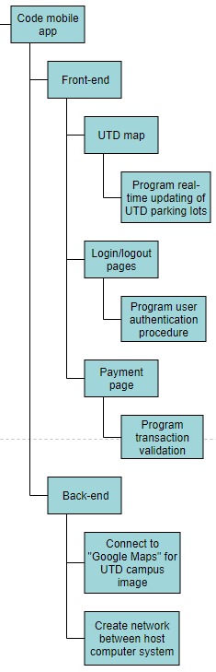
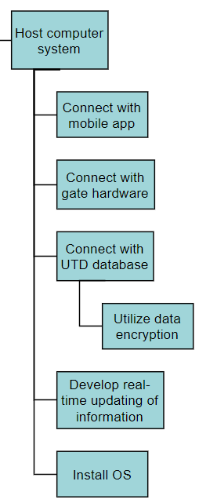
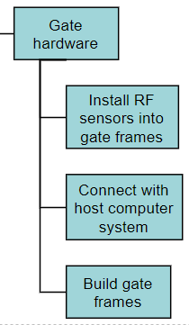
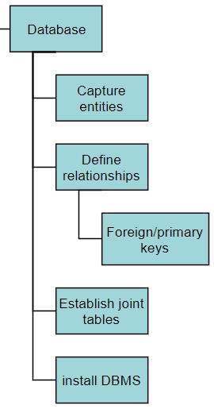
WBS: Development

Slide 13
WBS: Testing
Test networks
Test host computer system
Test database/back-end
Test gate hardware
Test mobile app
Find any issues with the system
Ensure system is secure
Ensure system won’t collapse under high usage

Slide 14
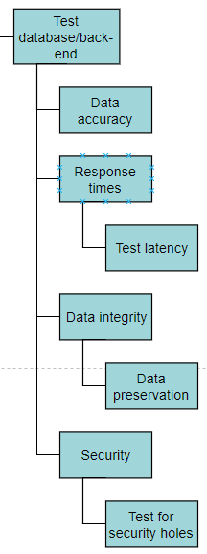
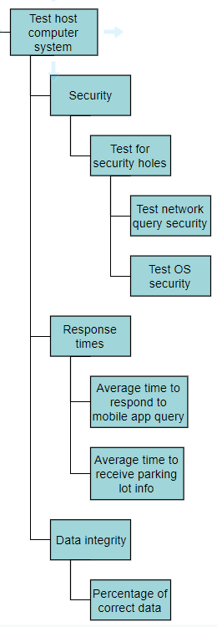
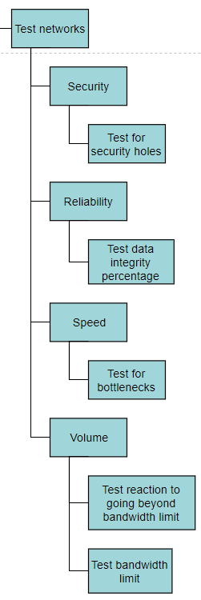
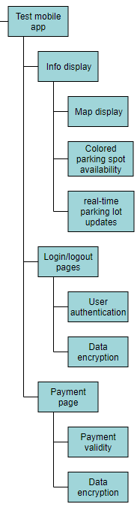
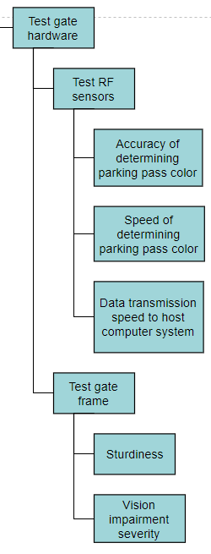
WBS: Testing

Slide 15
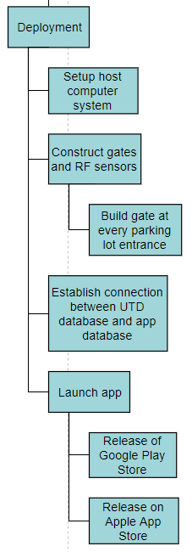
WBS: Deployment
Launch app
Connect UTD database and app database
Construct gates and sensors
Host computer system setup
Ensure everything is in place for launch day
All systems connected together
Make sure users have functionality

Slide 16
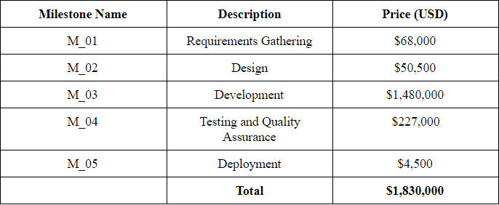
Pricing Milestones

Slide 17
Pricing Milestones Rationale
Based on the five project stages
Prices based on supplies estimates and wage averages
Average salary for requirements engineer, design engineer, software developer, etc. in DFW area.
Supplies cost (gate hardware) based on highway toll gates
Development cost come from coding, ordering supplies, and construction labor costs

